Slide 1
JUnit 5 Fundamentals
This course will teach you how to write unit tests with JUnit 5, covering topics like why unit tests are important, the structure of good unit tests, dynamic and parameterized tests, code coverage, and more.

Slide 2
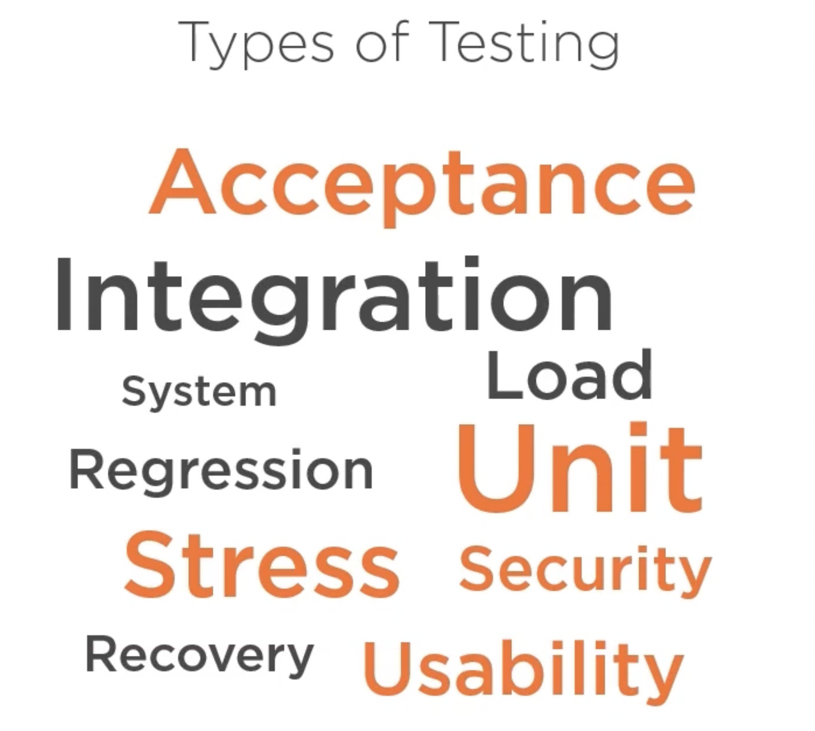

Slide 3
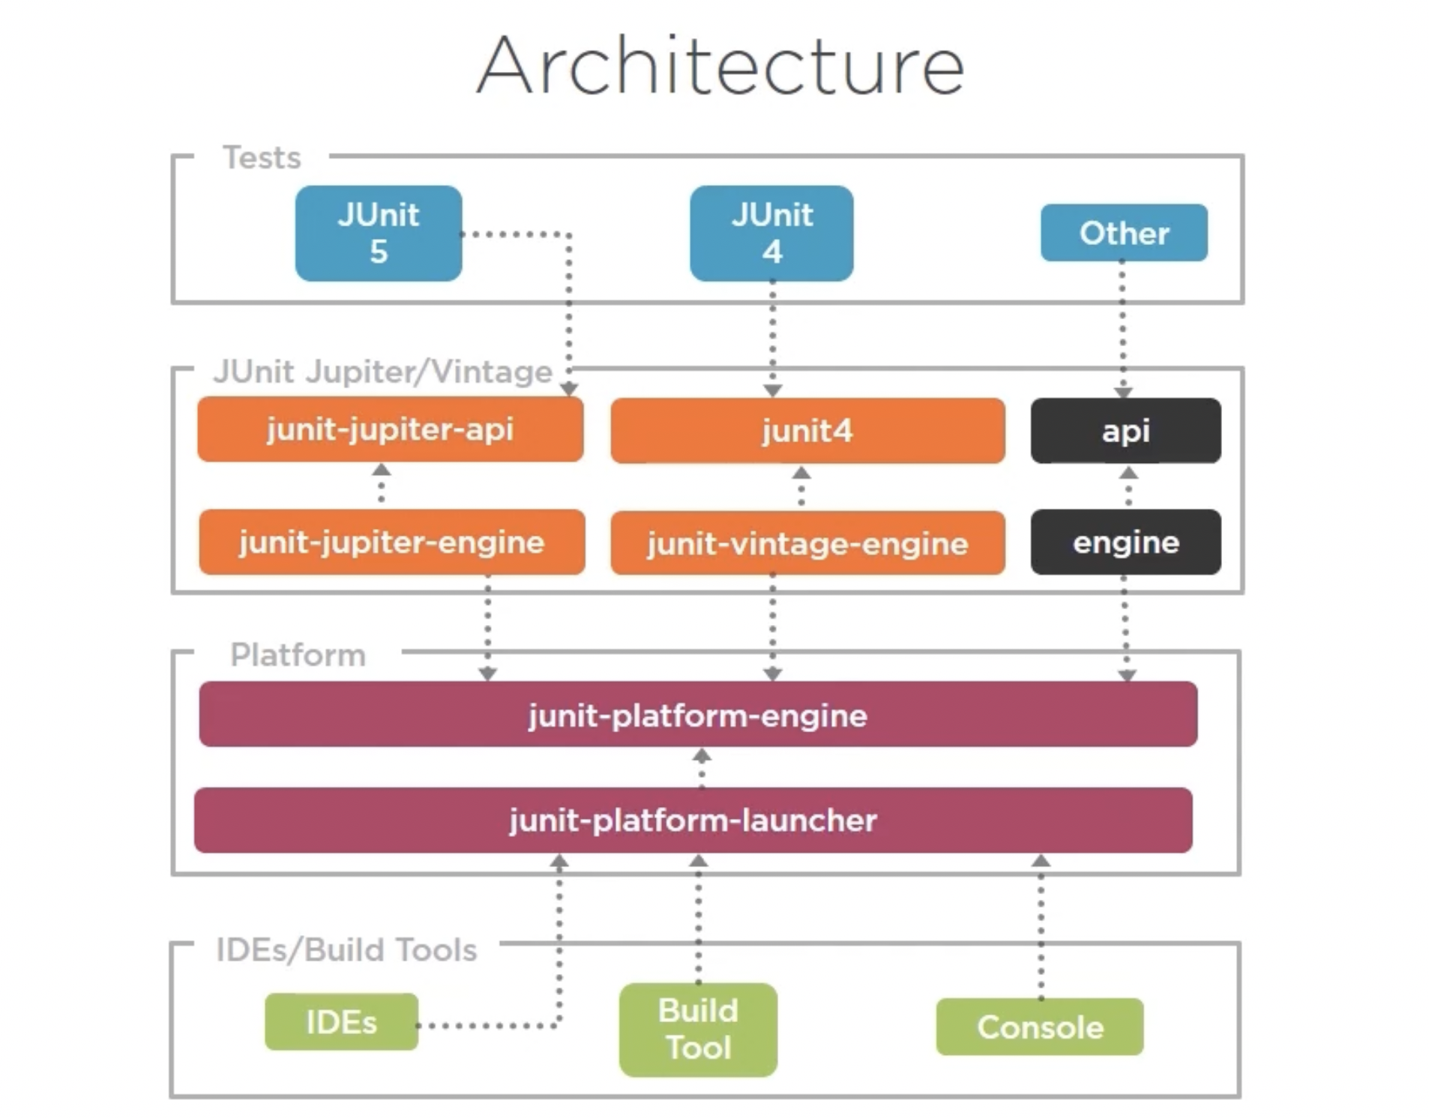

Slide 4
What would we learn through this course?
Architecture of JUnit 5
How to use JUnit to create tests
Integrate JUnit with Maven

Slide 5
Prerequisites:
Basic knowledge of Java 8
Streams, lambda expressions
Default methods in interfaces

Slide 6
What are the most important and popular Java frameworks?

Slide 7
JUnit is the standard tool for unit testing in Java

Slide 8


Slide 9
What is Junit?

Slide 10


Slide 11


Slide 12
Tests Must Be…
Easy to understand
Easy to read
Easy to modify

Slide 13
Types of Tests

Slide 14
According to the knowledge of the system
Black Box
White Box

Slide 16
Types of Tests
Unit

Slide 17
Unit Tests
Written by programmers
Test a piece of code

Slide 18
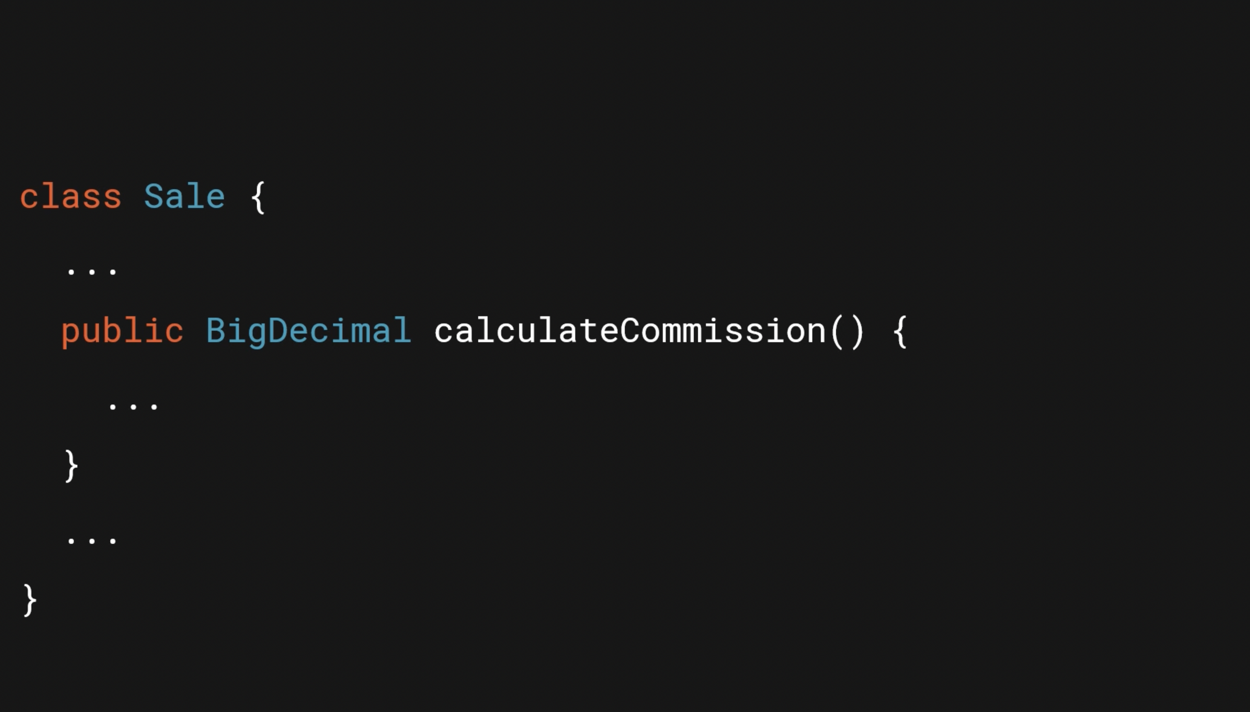

Slide 19
A Good Unit Test Should Be
Automated
Repeatable
Fast

Slide 20


Slide 21
Integration Tests
Test how components work together

Slide 22
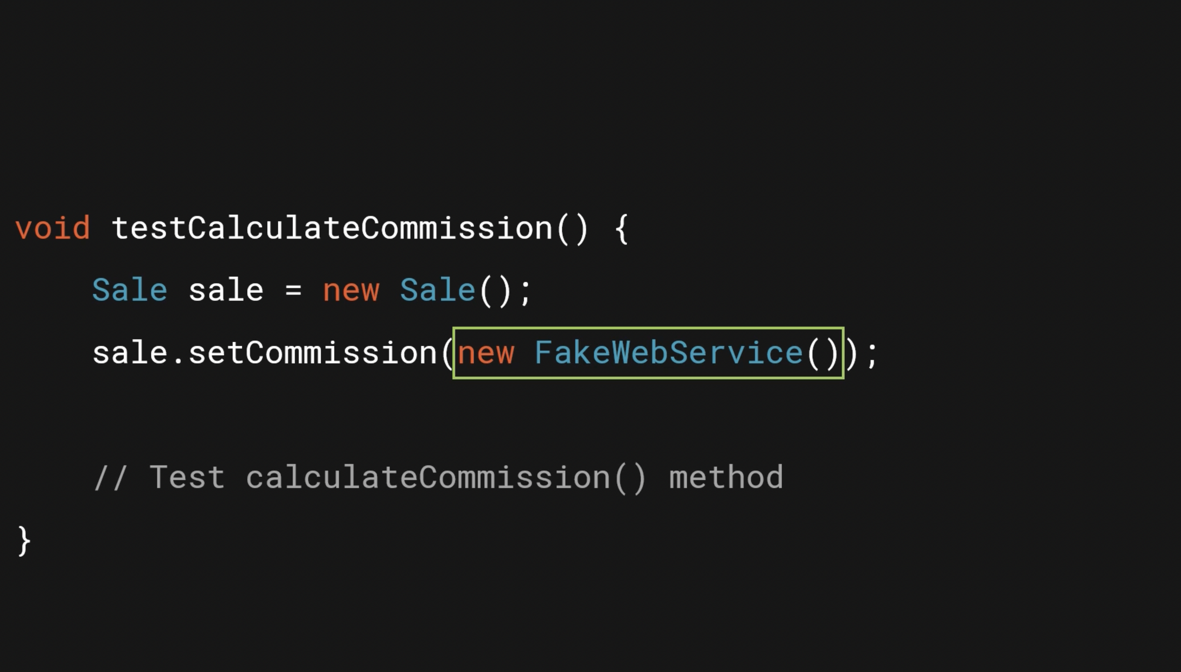

Slide 23


Slide 24


Slide 25


Slide 26
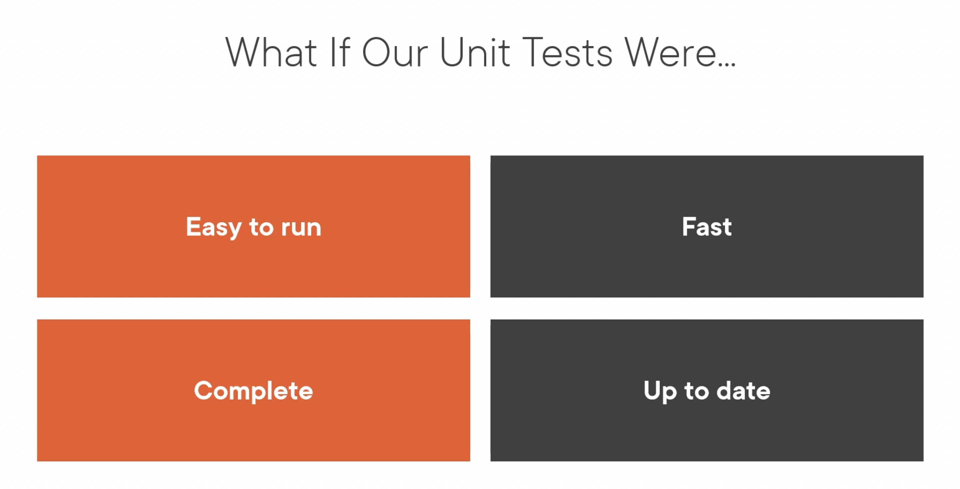

Slide 27
Courage

Slide 28


Slide 29
First JUnit 5 Test
Writing first JUnit 5 test
Integrating JUnit 5 with maven

Slide 30

Course Scenario

Slide 31
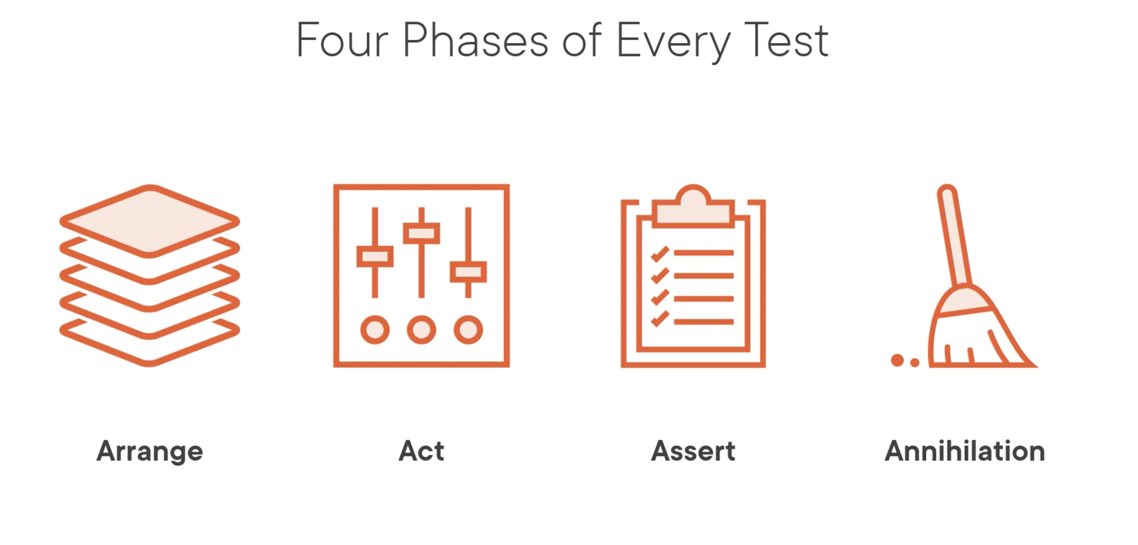

Slide 32
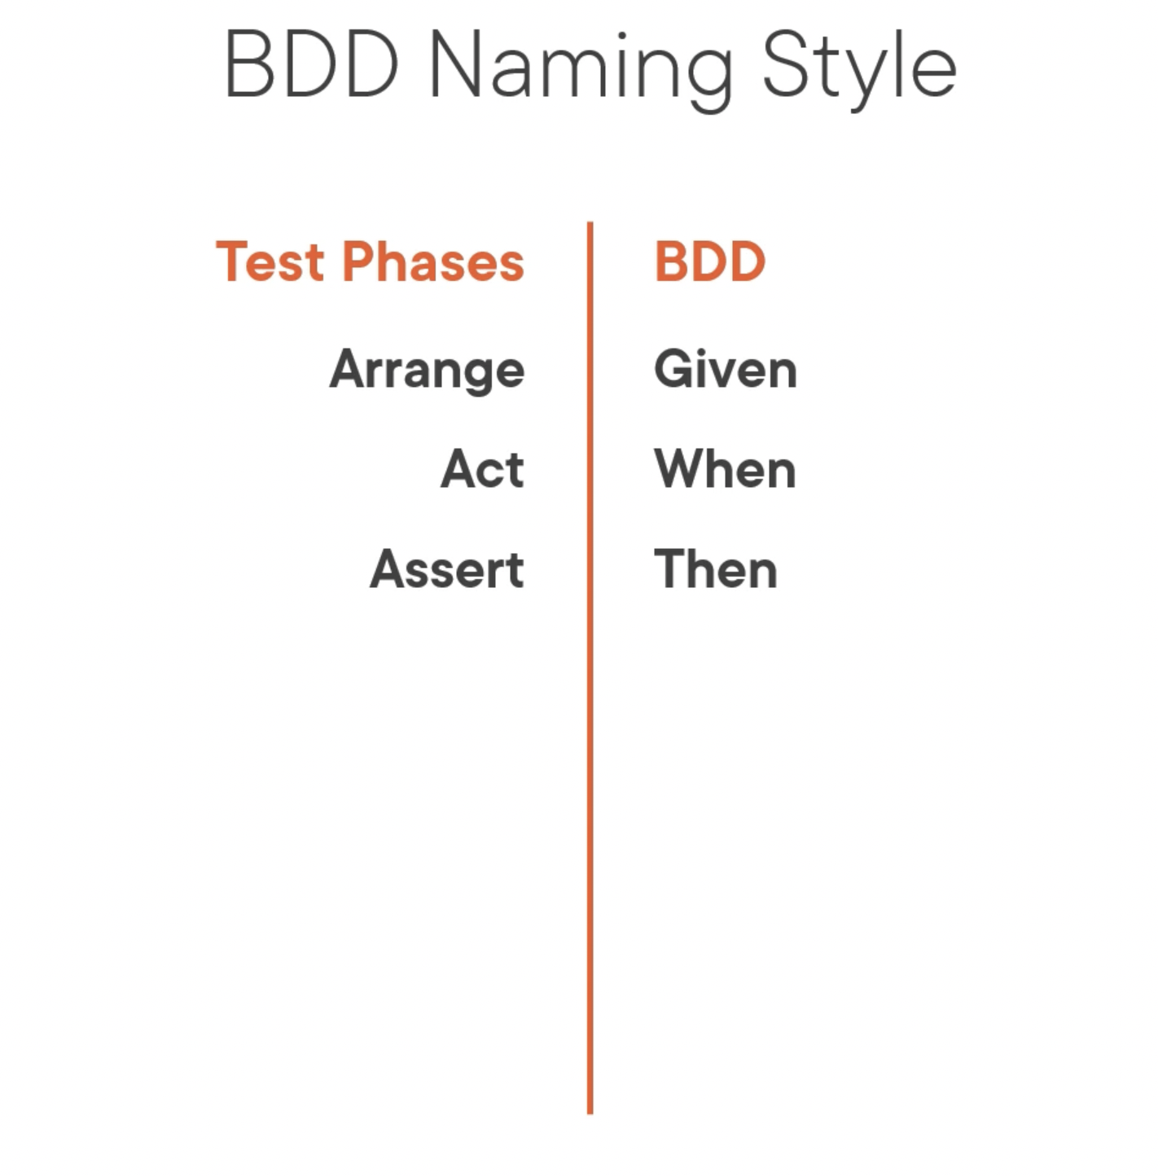

Slide 33


Slide 34
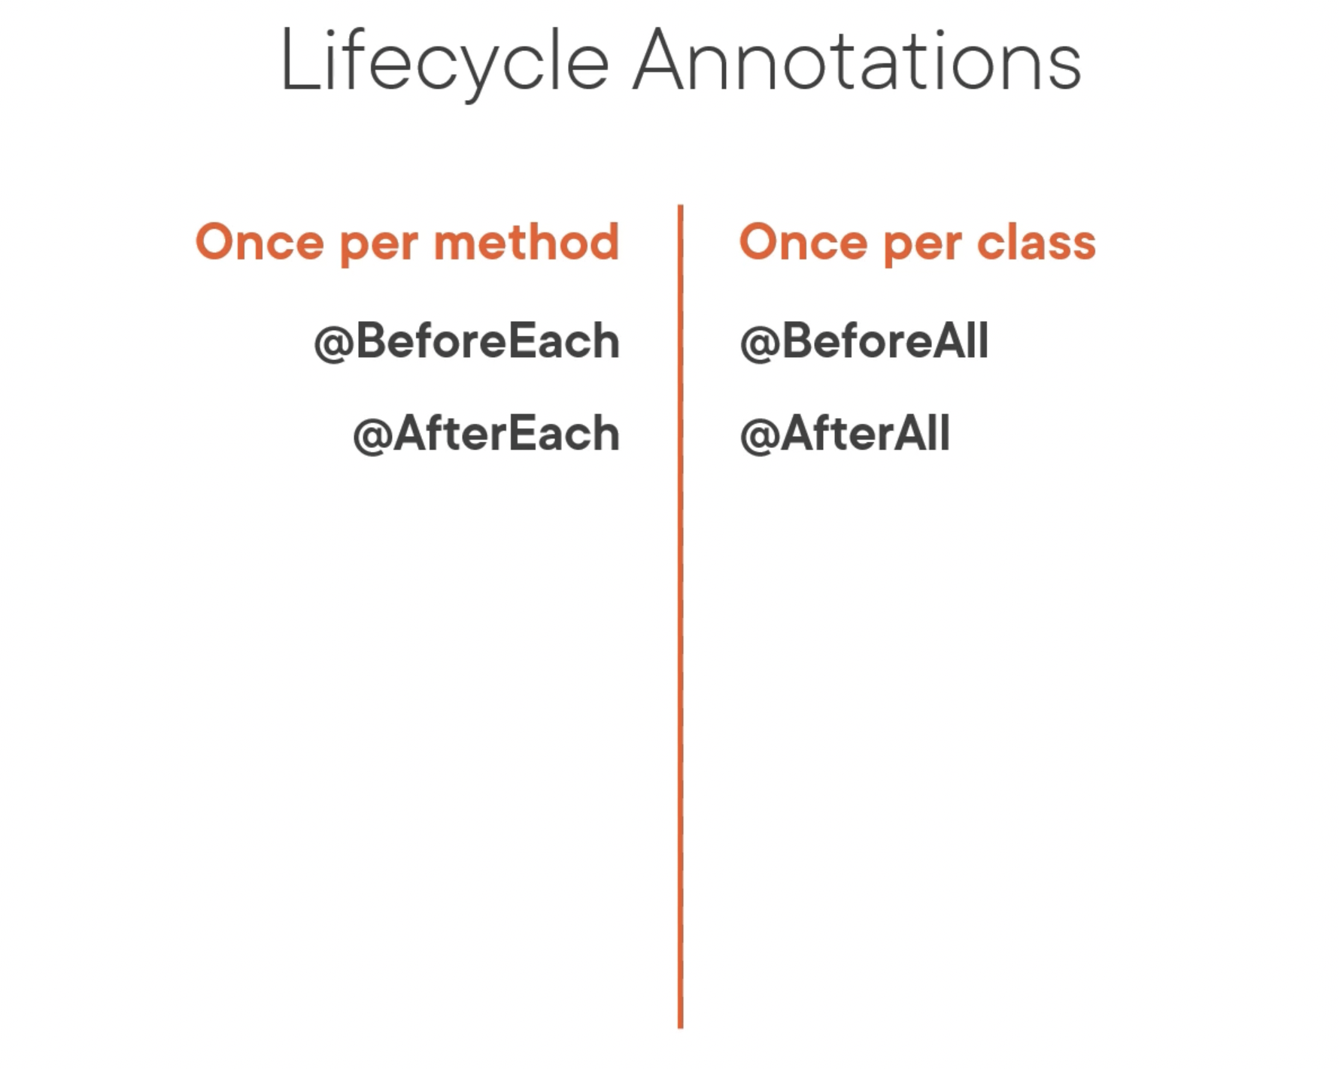

Slide 35
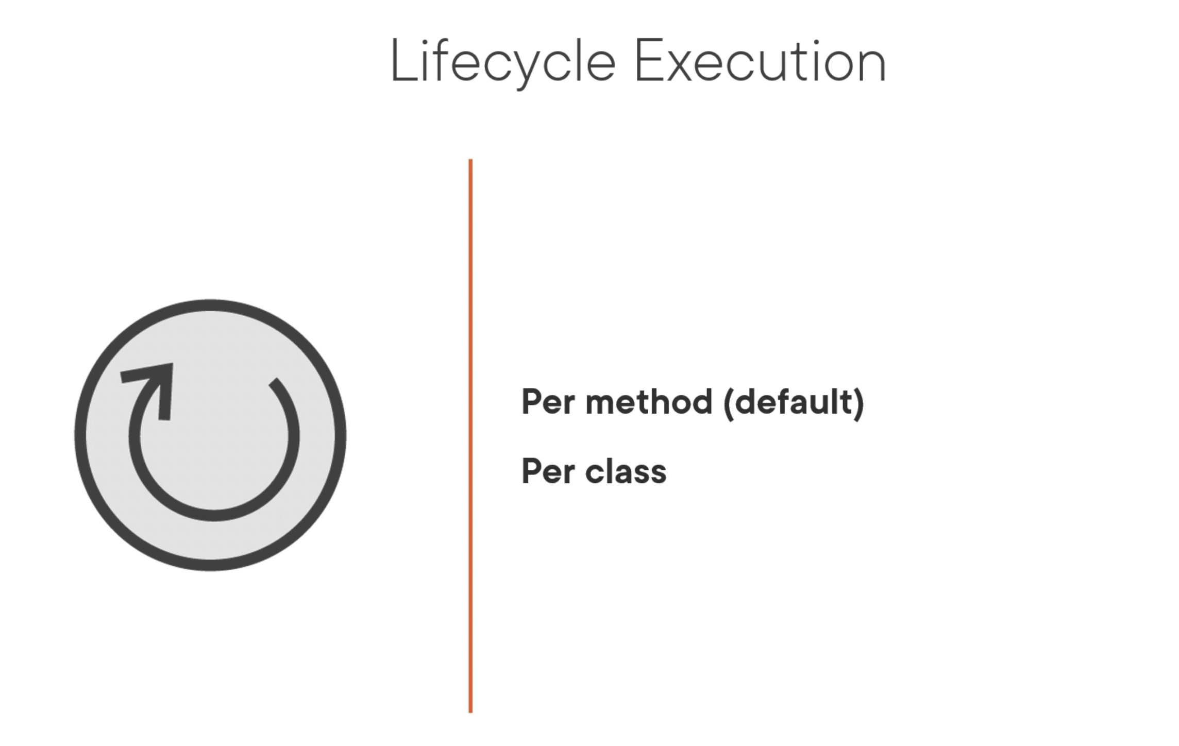

Slide 36
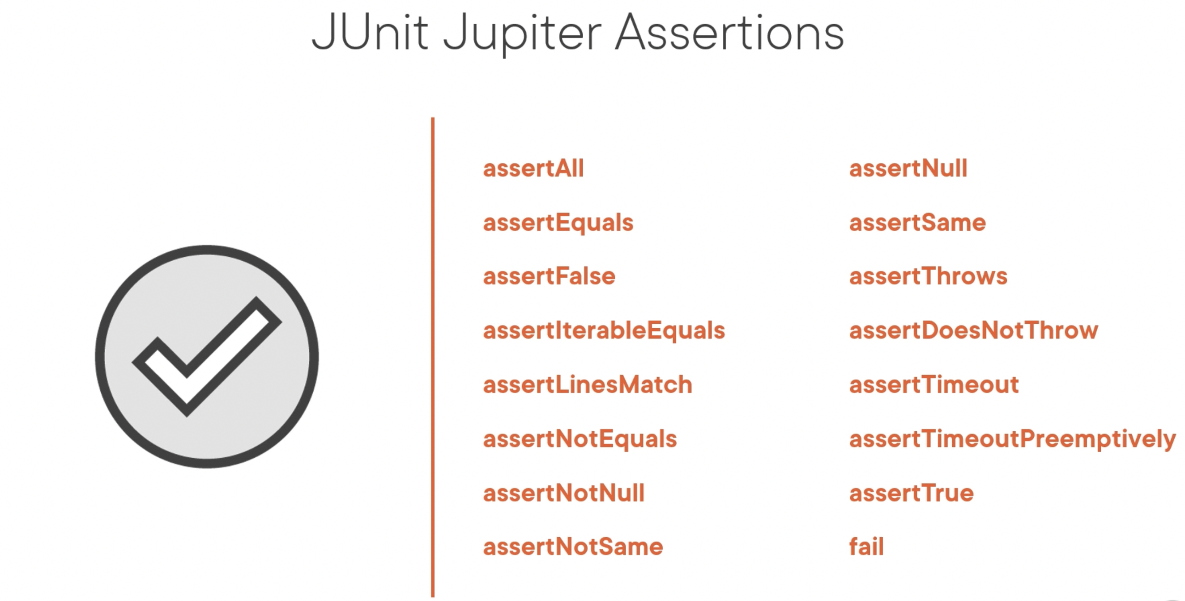

Slide 37
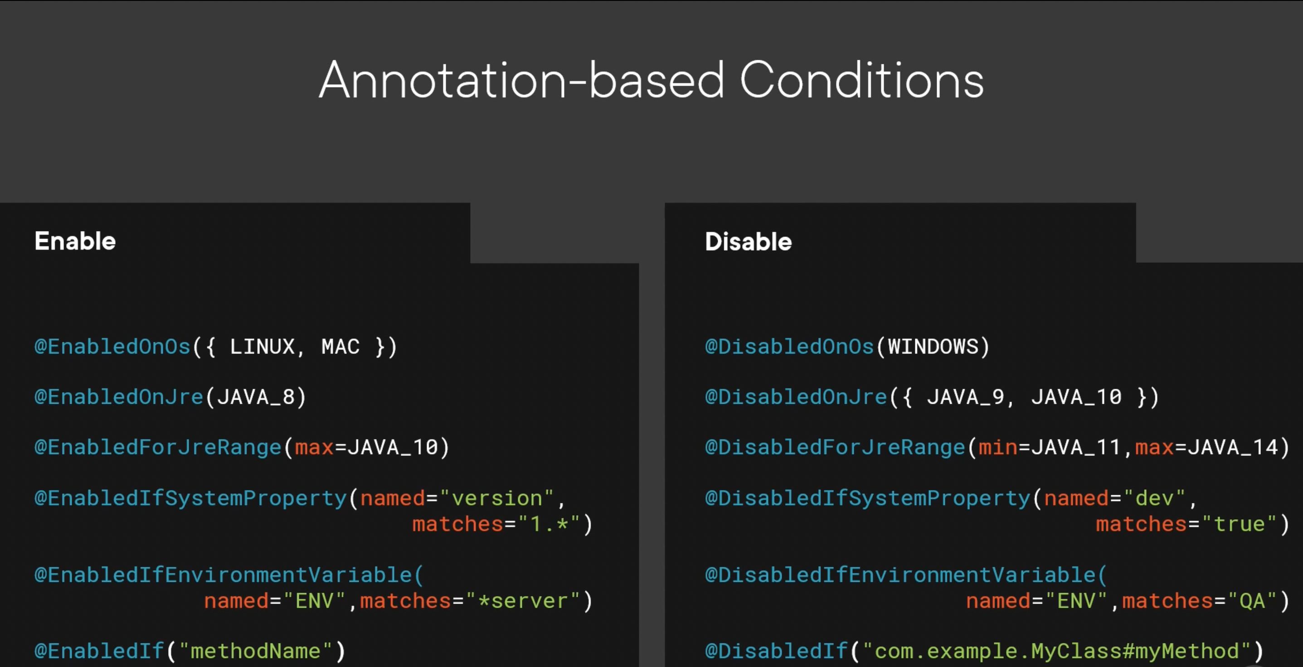

Slide 38
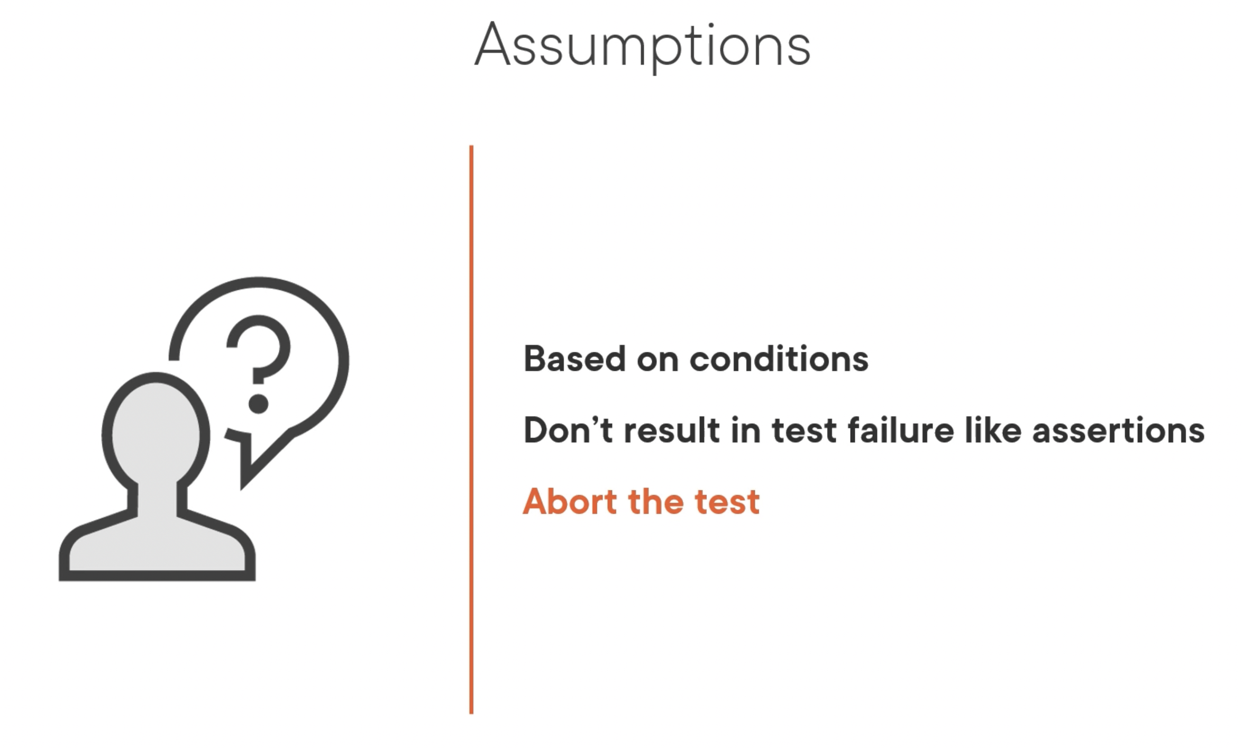

Slide 39
Summary
Test Structure
Life Cycle Methods
Test Hierarchies
Assertions
Disabling Tests
Assumptions
Test Interface and Default Methods
Repeated Tests
Parameterized Tests
Argument Sources
Integrating tests with Maven

Slide 40
Q & A

